Slide 1
Box Model + Positioning
WEBD 120 - Web Programming 1
Link to slides: http://bit.ly/humber-web-4
Ryan Christiani
Week 4

Slide 2
Assignment Review
Common pitfalls:
Indentation
Tags outside of the body
Misuse of tags
Missing components.
Please come talk to me if you have any questions about the assignment.

Slide 3
Review
Forms
Inline Level Elements
Block Level Elements

Slide 4
Forms
The form consists of 2 main elements. The form element and the input elements.
The form element has 3 main attributes. action, method, name.
action: the file to be called when the form is submitted
method: the type of method to use when you submit this form
name: used to identify the form.

Slide 5
Inputs
The input take has a type attribute. This lets you change the type of input you expect from the user, and in modern browsers it will change the appearance as well.
Some of the types:
text, search, password, date, number, range, email, etc

Slide 6
Inline Elements
● inline elements are only as wide as their content
● automatically floats left
● does not start on a new line
● cannot nest a block level element but can nest other inline elements

Slide 7
Block Level Elements
● automatically starts on a new line
● takes up the full width of the page
● can be nested inside other block level elements
● can also wrap inline level elements

Slide 8
Inline-block
This will take some of the characteristics from both block and inline.
The element generates a block element box that will be flowed with surrounding content as if it were a single inline box (behaving much like a replaced element would).

Slide 9
The Box Model
The browser looks at every HTML element on the page as a rectangle (inline and block).
Each of these rectangles may have margins, padding and borders, which in turn changes the element's size (width & height). The way these elements are
formulated together is referred to as the box model.
Understanding the box model is crucial for understanding how to position elements with CSS to create the desired page layout.

Slide 10
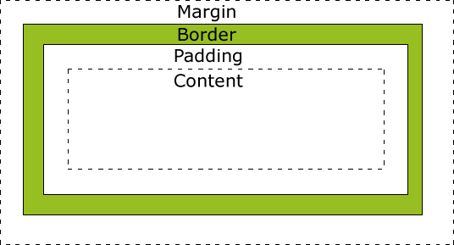
Box Model Breakdown
The content is the visible
text or image. The border
is... the border. Padding
and margin adds spacing
inside and outside,
respectively.

Slide 11
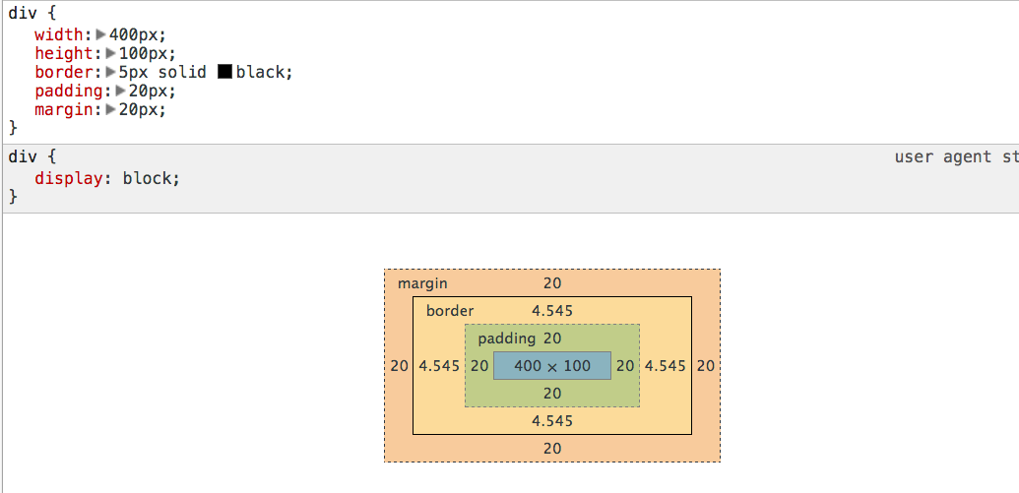
Box Model Breakdown
The original element
started at 400 x 100.
After adding padding,
border & margins
(CSS properties),
the size is now
492 x 192.

Slide 12
CSS measurement review
There are many properties used for declaring sizes. There are also many different units that can be used when defining the value.
PIXELS - most commonly used because monitors are measured in pixels.
PERCENTAGES - very useful for fluid and responsive layouts
EMS - scalable unit. A bit tricky to use but can be useful for getting really precise sizes.
http://www.w3.org/Style/Examples/007/units.en.html

Slide 13
Padding
The padding property adds space inside of the element. It only accepts numerical values. There is a longhand and shorthand way of declaring it.
p {
padding-left: 45px;
padding-right: 15px;
padding-top: 5px;
padding-bottom: 25px;
}
p {
/* top right bottom left */
padding: 5px 15px 25px 45px;
}

Slide 14
Padding syntax alternatives
p {
padding: 25px; /* 25px all around */
}
p {
padding: 15px 25px; /* top/bottom 15px right/left 25px */
}
p {
padding: 25px 15px 10px; /* 25px top 15px right&left 10px bottom */
}

Slide 15
Margin
The margin property is similar to padding but it adds space outside of the element. The syntax rules are the same as padding, including the shorthand and longhand rules.
p {
margin-top: 15px;
margin-right: 20px;
margin-bottom: 5px;
margin-left: 35px;
}
p {
/* top right bottom left */
margin: 15px 20px 5px 35px;
}

Slide 16
Centering with Margin
There is a nice little trick where you can use margin to center a block level element.
div {
width: 980px;
height: 500px;
margin: 0 auto;
}

Slide 17
Border
The border property resides between the margin and padding and creates an outline around the element. Also has longhand and shorthand syntax.
.product-box {
border-style: solid;
border-color: black;
border-width: 5px;
}
.product-box {
border: 5px solid black;
}

Slide 18
Border cont.
Like padding and margin, we can target a specific side of the element to add a border.
.product-box {
border-top-style: solid;
border-top-color: black;
border-top-width: 5px;
}
.product-box {
border-top: 5px solid black;
}

Slide 19
Border cont.
There are a few other styles for borders other than solid.
dotted
dashed
https://developer.mozilla.org/en-US/docs/CSS/border

Slide 20
CSS Floats
CSS floats are used to align elements left or right. This property also clears up the need to use deprecated elements and attributes.
.box1 {
width: 200px;
height: 100px;
float: left;
}
.box2 {
width: 200px;
height: 100px;
float: right:
}

Slide 21
Clearing floats
Floating an element takes the elements out of stacking order, think about building blocks. So the container holding these elements collapses. There a few ways to deal with this collapse.
First there is a property called clear , this can take four values. none, left, right, both. Or you can use a simple property called overflow, with the value of hidden.
Lets look at an example: http://jsbin.com/neciq/1/
Great article: http://www.quirksmode.org/css/clearing.html

Slide 22
Position
The position property is also used to align elements and comes with five different values: static, inherit, relative, absolute and fixed. Boxes with a position value other than static are said to be positioned.
Additionally, box offset properties, top, right, bottom and left are used to specify the direction and measurements for positioning elements.
The vertical placement of the elements in the stacking context is determined by the z-index property.

Slide 23
CSS position values
static: default, keeps elements within their normal flow. Offset properties are ignored.
inherit: the element takes the same value as its parent.relative: the element that it's applied to functions as a static element but acts as the primary container to any absolutely positioned element within it.
absolute: positioned relative to its containing block/parent element. Removed from the flow and have no effect on later siblings
fixed: absolutely positioned box, relative to the viewport.

Slide 24
RELATIVE & ABSOLUTE
Lets look at example, the parent element has a position of relative. The child element has an absolute position but it's position is relative to the container.
It is using offset properties, top and right, to be positioned 10px from the right and 10px from the top of the parent element.
Lets do this example together.
http://jsbin.com/rejipu/1/

Slide 25
Play around
Play around with floating and positioning elements on a page.
This is key to understanding the concepts of laying out a page.

